Slide 1
Tips on Preparing and submitting your entries
Saskatoon Photography Club

Slide 2
How many prints can I enter?
Competitions
Competitions have specific limitations
Please see the website for details
Reviews
Images submitted in a Review can later be entered into a Competition
Images submitted into a Competition can NOT be re-entered in a future Camera Club competition.

Slide 3
Print size of your submission
Print Size
Minimum size
8 in X 10 in
Maximum Size
18 in X 24 in
The overall size of the print once ready for submission can not exceed the 18 in X 24 in including the matboard.
The minimum size of the print must not fall below 8 in X 10 in. This is for the print alone, not including the matboard.

Slide 4
How to mount your photo
All photos will need to be mounted so that they can be displayed for the judges
Photos should be mounted on foam core or matboards
Mounting on foam core can be done yourself or you can have a local print shop print on foam core for you.
Matboards can be purchased locally or online. Please ensure the outside dimensions of the matboard fall within the size parameters for print submissions.
NO frames are allowed!!!!

Slide 5
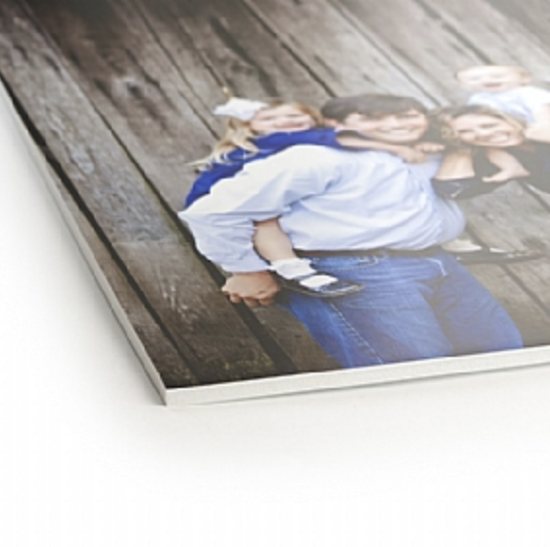
How to mount your photo
Foam core mounted photo
Using foam core allows the photo itself to be larger.
Some photos look best without a border, others look best with a border.
Foam core is the best option for photos that look best without a border

Slide 6
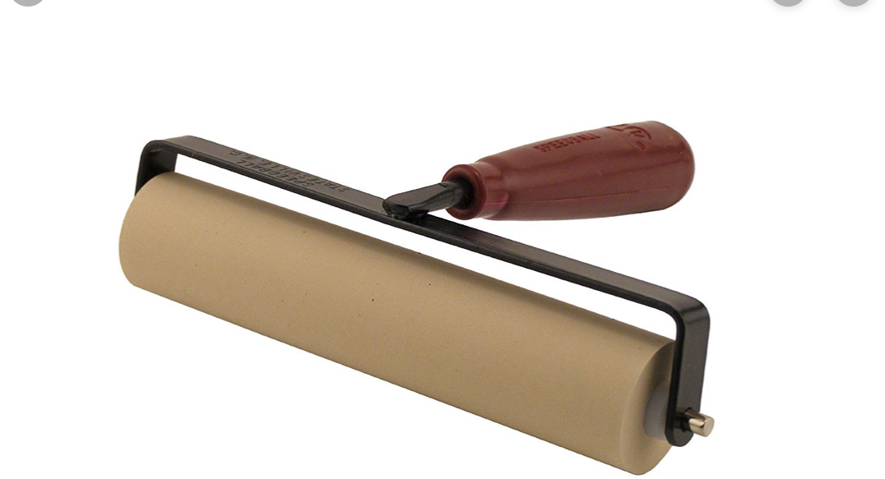
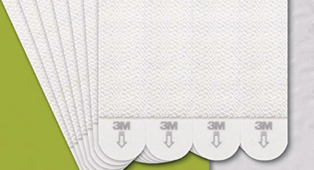
How to mount a Print on foam core
You will need the following supplies
Spray Adhesive
Newspaper or large painters' tarp
Exacto knife or equivalent with a very sharp blade
Brayer style roller
Large ruler (heavy duty metal is best)
Cutting matt or wooden board
Picture hanging strips

Slide 7
How to mount a photo on foam core
Cut the foam board larger than your print
Place the the print on newspaper or painters tarp face down
Spray the the print with spray adhesive then carefully pick the print up and smooth the print on the foam board, glue side down. Be sure to do this in a well ventilated area.
Use the brayer roller to smooth the print on the foam core and remove air bubbles
Place the print on the cutting surface
Place the ruler where you want to cut the edge of the photo. Hold the ruler very firmly and use a very sharp knife to cut the edge.
Foam core is very light and can be displayed using Velcro type picture hanging strips.

Slide 8
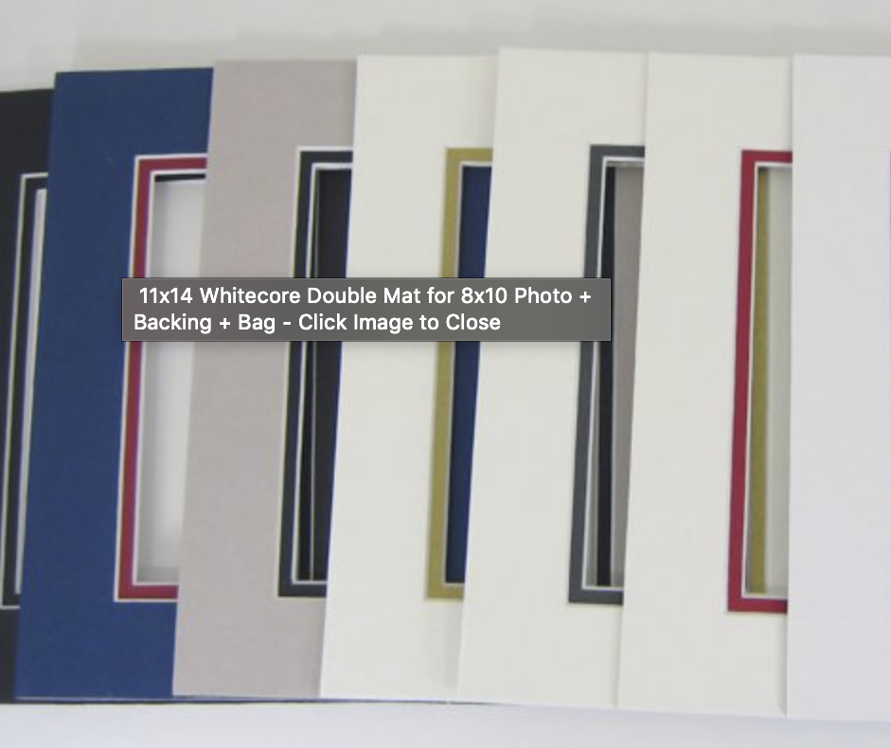
How to mount your photo
Matboards are best if you think your photo looks best with a border.
Matboards come in many colors.
Choose a color that complements your photo or matches the mood of the photo.
Remember the over all size including the matboard must fall within the size guidelines.
If your photo is mounted on matboard, please make sure it is attached securely. The prints are handled quite often during organizing, displaying, judging and results night so it is imperative that they are securely mounted.
Scotch tape does NOT work well
Masking tape or Gaffer’s tape seems to work. Results can vary based on brand.
If your photo will be mounted for a long period of time and/or will be framed, you may want to consider archival mounting tape so the photograph will not be damaged by the glue.

Slide 9
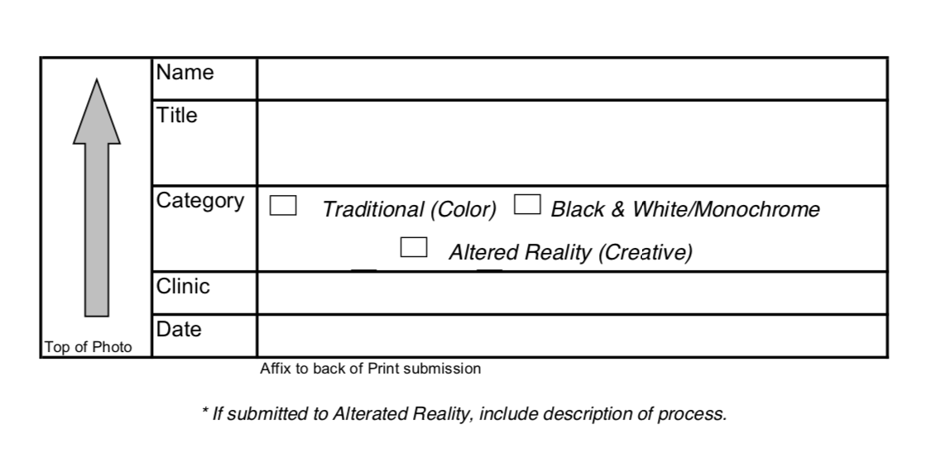
Packaging your submission
Each photo MUST have a label.
Each label should be filled out and attached to the back of the print.
The label should be attached so that the arrow on the label indicates the top of the print.
On occasion it is difficult to tell which side of the print is the top. To ensure your print is displayed as you intended, the label must be attached correctly with the arrow indicating the top of the print.
If your print is being entered into the altered reality category, please ensure to give a brief description on your label of the technique involved in creating the image.

Slide 10
Packaging your submission
These labels can be downloaded from the website.

Slide 11
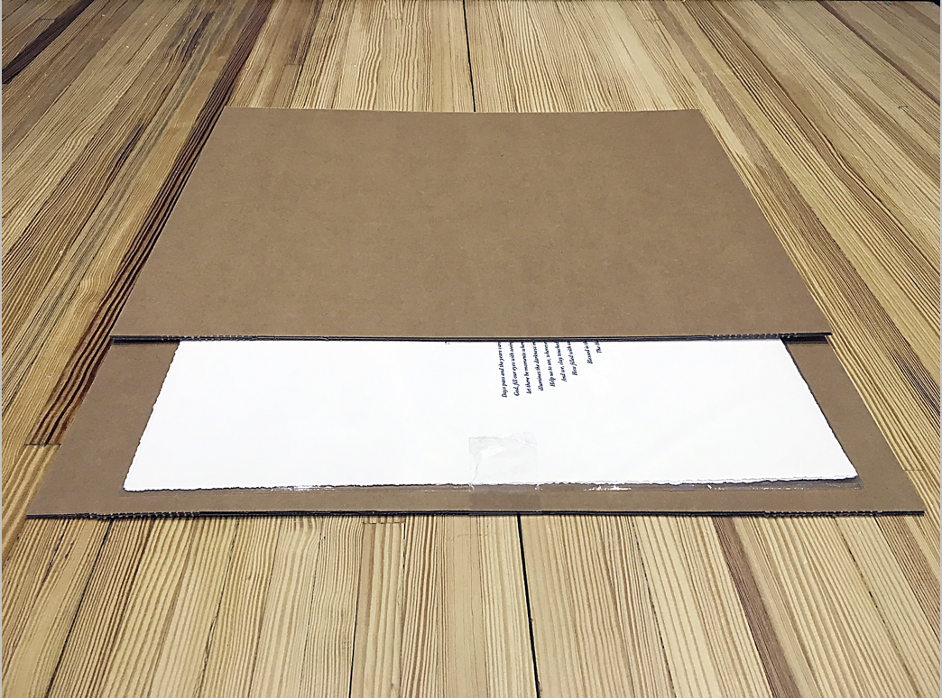
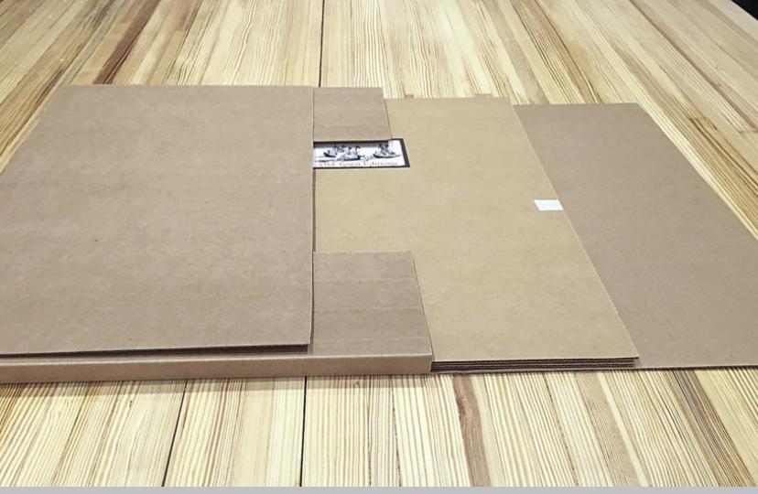
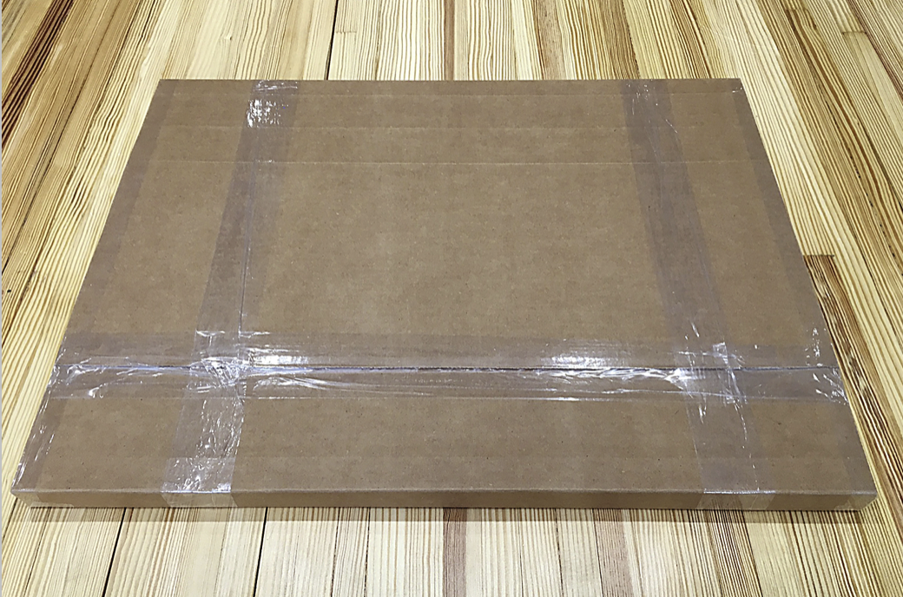
Packaging your Submission
All photos should be submitted within a protective sturdy cardboard folder or sturdy bubble wrap envelope.
Ensure you label the outside of your print envelope/box with your name so it can be returned to you on the results night.
If the print is ordered from a print provider, they are generally packaged well. Keep this packaging if it will work for submissions.
This is an example of print packaging that will work well.

Slide 12
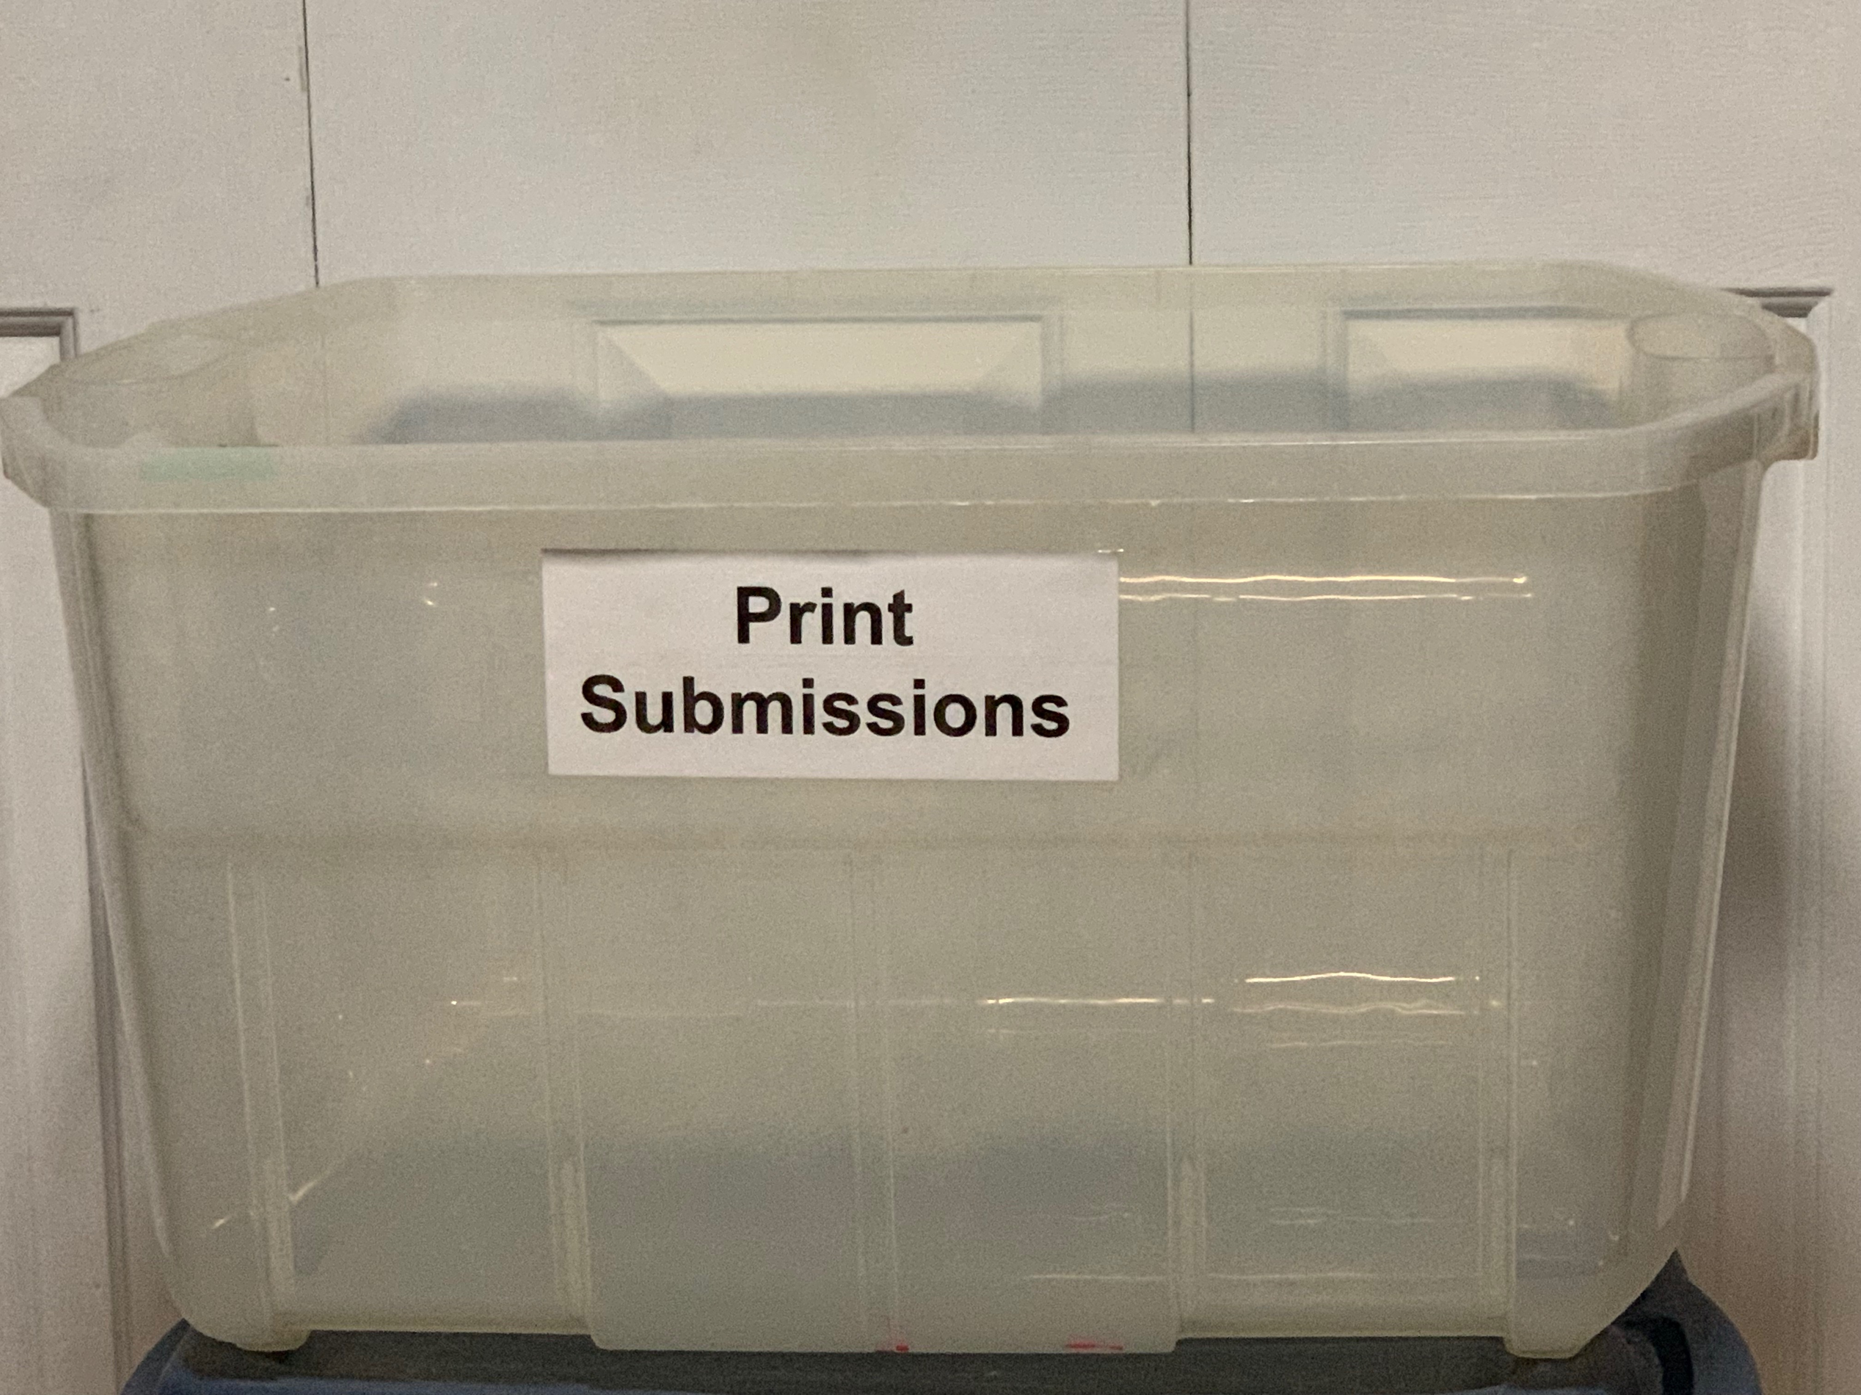
When to submit prints
The Saskatoon Camera Club website will outline the agenda for each evening of meetings scheduled for the club each year.
The dates for Clinic and Competition submissions will be listed on the website
All prints are to be submitted during the submission meeting.
On Submission nights there will be a white plastic bin marked “Print Submissions” or a table set up for the submissions. Place your print submission inside this bin or on the table.

Slide 13
Submitting a digital copy of your print
Even though you are submitting a print to the clinic/competition you must also submit a digital copy.
The judges will evaluate the printed version not the digital version.
The digital version is displayed so that the camera club members can see which photo is being discussed and a digital version is also needed to include the entry on our website. Please make sure the digital copy is the same as the printed version.

Slide 14
Submitting a digital copy of your print
Images are submitted online in the same manner as those for the digital competition.
Images must be submitted as jpegs
We strongly recommend that you send us your full resolution photo.
Images must be in the proper orientation for viewing when projected.
Images do not have to have a 4:3 aspect ratio.
For files to upload they must be less than 32 MB
Minimum File Requirements for our Projector
The optimal viewing area is 1280 x 800 (width x height) per image
Vertical images have a minimum height of 800 pixels tall.
sRGB
Image submitted smaller than these resolutions will be shown at their submitted dimensions

Slide 15
Good Luck!
We look forward to seeing your submissions!

